Slide 1
January 31, 2016 Praise God with all your Heart.

Slide 2
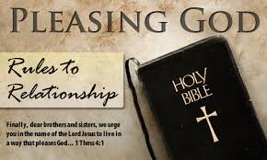
I Thessalonians 5:12-18 Pleasing God!

Slide 3
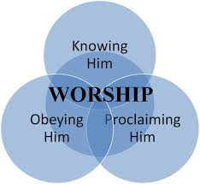

Slide 4
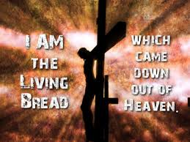

Slide 5
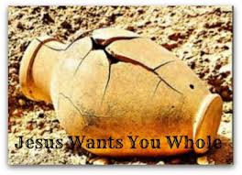
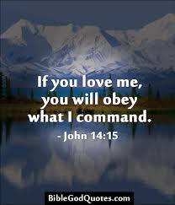

Slide 6
I Thessalonians 5:12-18 Pleasing God!

Slide 7
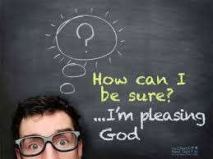

Slide 8
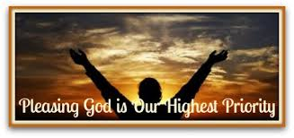

Slide 10
Introduction: If you’ve been around churches for awhile, you begin to see that many of them have sick or unhealthy things going on among them. Sometimes you find factions, judgmentalism, and power struggles of various kinds. Point being, if we act like that then how can we attract people to Christ, grow spiritually, even please God? All I want to hear is “Well done, good and Faithful servant!” What does it take to hear that from God? A lot of passages use the term, “this pleases God.” Our focus is to do what the will of God is. I’m asked a lot, What does God want from me?
What we see in our text of I Thessalonians 5:11-18, can give us an idea on how we are to behave among ourselves as a congregation of disciples and be in God’s will and please Him.

Slide 11
*Live with your brothers and sisters in mind! (vs.11) Encourage, build up. Time, effort, planning, finding opportunities by staying in contact, patience, love, hope, prayer, dedication, living a life of example. *Respect your Leaders! (vs.12-13) Whether it be Elders, Deacons or those that stand up to provide service to us in leading. 1)Labor-to grow weary, tired, toll, are burdened, to exert oneself physically, mentally, spiritually. Those who take responsibility!
2) Have charge-to exercise a position of leadership, rule, direct, to be at head. It is used of a father managing a family.
3) Admonish you-to counsel about avoidance or an improper course of conduct, warn, instruct. Used in the context of gentle, loving correction.

Slide 12
*Be family Focused! (vs.14-15) “And we urge you, brothers, warn those who are idle, encourage the timid, help the weak, be patient with everyone.” 1) Admonish the idle-them that are unruly, those not in proper order, soldier out rank-being out of step and going one’s own way, disorderly, insubordinate. Both in physical and spiritual things. One example is someone not using their talent to please God.
2) Encourage the timid-Some have a lot of persecution in their lives and need to encouraged to stand up rather than hunker down and rear back, in the midst of criticism, isolation or rejection.

Slide 13
3) Help the weak- Probably those who are suffering attacks on their faith but also those who are ill or weak in other ways. We are to Lift up their hands. Lift up the sick, down trodden, worn out and distressed because of life in the flesh. 4) Be patient with everyone- To bear up under provocation with out complaint. forbearing!
5) Kind not Vengeful- Absence of a judgmental spirit. In some congregations an unfortunate condition is spiritual pride. Pride in a self righteousness, which can lead to a condescending attitude towards who don’t seem as spiritual. Vengeful is a childish desire to get even. Open love prevents a judgmental, vengeful attitude and behavior.

Slide 14
*How do we accomplish this? Paul told the Thessalonians in (vs.16-18). 1) Be Joyful- Not be happy in spite of yourself, or put on a good face. This is instruction to praise God and enjoy the presence of God, even when circumstances around us are adverse.
2) Pray continually- Paul doesn’t mean mumbling prayers by rote without stopping all our waking hours. It means that prayer should be an integral part of our lives. Constantly turning our heads and hearts toward God.
3) Giving thanks in all circumstances- Expressing appreciation for benefits or blessings. Thanksgiving is the language of Faith.

Slide 15
Conclusion: Notice this with me. (5:18b) Paul says, “This is God’s Will for You in Christ Jesus.” What is God’s will for you right now? What will please Him? At the moment you may not know what the future holds or the answer to some crucial decision you need to make. But you can be sure about one thing-how God wants you to act in the circumstances in which you find yourself at this moment. I Thessalonians 4:1, “Dear brothers and sisters, we urge you in the name of the Lord Jesus Christ, to live in a way that please God.”

Slide 17
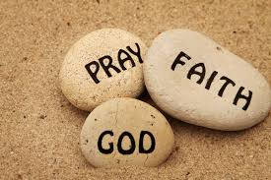

Slide 20
