Slide 1
Welcome Saints! February 21, 2016

Slide 2
Psalms 119: 57-64 God’s Favor! (vs.58)

Slide 3
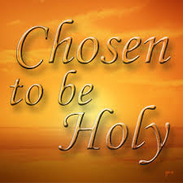

Slide 5
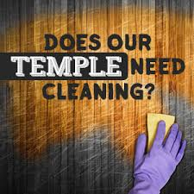

Slide 6
Psalms 119: 57-64 God’s Favor! (vs.58)

Slide 7
Examine: Psalms 119 shows us that the Word of God should have top priority in our lives. It stands as the giant among the Psalms, it is the longest psalm and longest chapter in the bible-176 verses. Since the Book of Psalms is the longest book of the Bible, it shows us the priority of praise and worship to God, and also shows us the priority of God’s Word to God.
The psalm is an acrostic or alphabetic psalm, in which there are eight couplets beginning with each of the 22 letters of the Hebrew alphabet. (Message)
1) The Bible is God’s Authoritative Word.
2) The Bible is God’s reliable Word.
3) The bible is God’s powerful Word.

Slide 8
a)The Word brings us into a Living Relationship with the Living God. b)The Word gives us stability in Trials. c) The Word gives us Direction in Life. d)The Word produces Purity in our lives. e)The Word gives us Joy and Delight.
4) The Bible deserves top Priority in our Lives.
1) We must learn God’s Word.
2)We must obey God’s Word.
3)We must love God’s Word.

Slide 9
I also learned something about the author and his encouragement for others and God’s Word. 1) “I have promised to Keep…vs.57.” 2) His request, “Be gracious to me…vs.58.” 3) “I considered…and turned my feet..vs59.” 4) “I hastened and did not delay…vs. 60.”
5) “I have not forgotten…vs.61.”
6) “At midnight, rise up to give thanks…vs.62.)
7) “I am a companion of those who fear You…vs.63.”
8) “Teach me…vs.64.”

Slide 10
Explain/Focus verse: Psalms 119:58, “I sought Your Favor with all my heart; Be gracious to me according to your word.” God’s Favor! Vines Complete Expository Dictionary defines “favor” as goodwill, acceptance, will, desire or pleasure.
Another definition is a kind or friendly attitude or act, an indulgence or friendly regard or approval shown to one by a superior; partiality. It can also be defined as the condition or being held in regard or approval or support.

Slide 11
What the author is saying is that I am desiring, seeking your face God, that is to come into your very presence. There I will find approval, acceptance and support because of who you are and the promises of Your word. Because the author is a sinner and only in getting God’s favor will he find the answers for life and recognition even of his own self worth. The presence of God is the highest form of His favor, and therefore it is the most urgent desire of any soul.
God I am doing it with my whole heart! Vs.58
Heart defined: Inner man, mind, will, affections, soul, knowledge, thinking, reflection. The center and seat of spiritual life, soul or mind as it is the fountain and seat of the thoughts, passions, desires, appetites, purposes and endeavors.

Slide 12
The writer is talking about prayer that involves all that he is inside and out. He ask for nothing beyond the promises in His word, and he begs for mercy as the word reveals. Desiring God’s presence and favor involves the heart of man and Prayer is chiefly a heart work. You see God hears the heart without the mouth, but never hears the mouth acceptably without the heart!
God’s response to those who seek Him and will keep his word is this. Jeremiah 32:41, “I will rejoice over them to do them good and will faithfully plant them in this land with all My heart and with all My Soul.” God in the Old and New Testaments is true to Himself, and will not turn His back on those who seek His presence with a whole heart.

Slide 13
Experience: God’s favor the one thing needful, Wholeheartedness is the greatest avenue to get it, God mercy is a gift needed. *Favor, acceptance, approval’s importance. Women’s story!
God is partial to us:
Eph. 1:3 Every spiritual Blessing
Jn. 15:13-15 God’s friends, Great Love.
If you really want to experience this favor, Stay in Christ-evaluate your life and prune out that not pleasing to God, Seek Him with a whole heart, Think about your ways and turn your feet to God’s Word. Finding His Favor is the greatest blessing we can have verses any other on the earth.

Slide 14
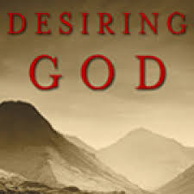

Slide 15
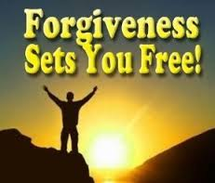

Slide 16
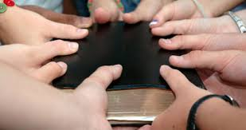

Slide 17
