Slide 1
May 29, 2016 Let us worship God Together.

Slide 2
Quiet waters! Psalms 23

Slide 3
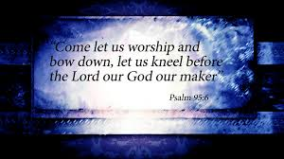
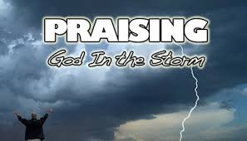

Slide 4
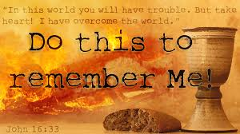

Slide 5
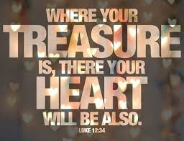

Slide 6
Quiet waters! Psalms 23

Slide 7
Examine: This Psalm is attributed to David and he was just like us. He was tempted over his life on many occasions, not the least of which was the time when Saul was seeking his life, to become anxious and worry. Some commentators believe this was the background to this psalm. But David overcame worry by trusting and rejoicing in God.
Psalms 23 can provide a model for us to follow throughout our lives as we respond to all the difficulties and anxious times that come our way.

Slide 8
This psalm has two basic divisions, each one providing part of the answer to our question about worry. The first four verses focus on God as the faithful and good Shepherd. It calls us to trust Him as such. The second section made up of the last two verses, focuses our attention on God as a gracious host, preparing a splendid meal for a guest, and results in our rejoicing over His grace toward us.

Slide 9
Explain: I. Trust God as the Good and Faithful Shepherd A. To provide for you 1) YHWH is personal. As you see, David says in the first section, verses 1-4, the YHWH is a faithful Shepherd. God is a personal Shepherd. David says the Lord is my Shepherd.
It’s as if David were saying that he knew that the God of the universe was personal to Him and in control, as a good Shepherd, of his whole life. Some versions say, “The Lord is my shepherd, I have everything I need.” Like a good shepherd YHWH gives Himself to us and therefore, we really lack nothing. The rest of verses 2-4 simply bear this out.

Slide 10
2) His provision is perfect. David says that a good shepherd leads his sheep to green pastures and quiet waters. The green pastures probably refer to the tender young shoots that grow up in the morning, and the quiet waters probably refers to a well-spring with fresh water. The psalmists wants us to understand that this Shepherd goes all out for his sheep.
The Shepherd wants them to have the best and is likewise sensitive to their needs. David wants us to understand that YHWH does the same for His people, and as we seek God, we are not getting second best from Him. He is a faithful Shepherd to give us only what is excellent according to His own purpose and agenda.

Slide 11
3) His provision renew and satisfies. The first part of verse 3, that is, “He restores my soul,” should be understood first of all on the level of the metaphor of the sheep and its shepherd. The green pastures and quiet waters, provided by so caring a shepherd are for the physical nourishment and energy of the sheep. The shepherd literally revives the life of the sheep.
God’s provisions for David and for us accomplishes similar ends. Whether it is physical needs that are met or spiritual, it revives or rebuild us. Ultimately it strengthens our trust in God and enlivens our spiritual sensitivities toward Him. It satisfies our longing.
But God’s faithful provision is only part of what He does for those who know and love Him.

Slide 12
B) To Guide You. “He guides me in paths of righteousness for His name’s sake.” (3b) 1) He guides you in righteous paths. As we go thru life God guides us, as a good shepherd, along paths of righteousness. For the sheep this means right or true paths; paths that are certain to lead to the places of rest and provision in verse 2.
For David, God desired to lead him down paths of uprightness during his kingship and enable him to win great battles, and possess the land of promise to the nation. But for us God desires to lead us into greater and greater righteousness in our lives as well. Also He wants us to win the battles we face, living in a world that brings difficult and challenging times into our journey thru life.

Slide 13
2) He guides you for His name’s sake. The end of verse 3 gives the reason why God was such a faithful Shepherd to David and still is for us today. He does it for His own name’s sake. That is, it is for the sake of the glory and reputation of His own name and honor. This is to demonstrate He is not a careless and irresponsible with His own sheep. God’s name is on the line in our lives. He wants to show the world that He is faithful to provide for all our needs and guides you in righteous paths, in a holy life.

Slide 14
C) To protect you. David says, “Even though I walk through the valley of the shadow of death, I fear no evil; for you are with me; your rod and your staff, they comfort me.” Possibly deep ravines with sharp cliffs where danger was imminent, either from the cliffs or animals hiding and waiting for prey. David says, “and so it is with life.” We often travel through dangerous circumstances in life, but we need not be overcome with fear for the shepherd is with us, able to ward off any danger by His rod and staff.
God is able to protect us from dangers we face. He is not a hired hand as it were, He is the Faithful Shepherd (cf. Jn.10:14). He will only permit what in His wisdom is ultimately good for you and will never allow permanent separation to come between you and Him.

Slide 15
II. Rejoice in God’s grace. A) Because He Spares no Blessing (5). “my cup overflows” B) Because it Results in Constant Fellowship with Him (6) “Surely goodness and mercy will follow me all the days of my life.”

Slide 16
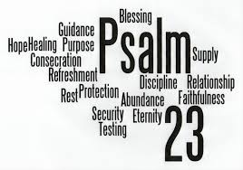

Slide 17
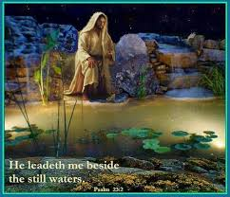

Slide 18
Still water; Hebrew, “Waters of rest” such as sheep love to drink of, void of danger, and yielding refreshment. Peace, calm, hope verses worry, anxiety, fear, and hopelessness. Have you ever drank of these waters? Still waters are with us all the Journey through! Those moments when God calls out to us to drink of Him and let Him be our Shepherd, and give us refreshment. (Fits your need).

Slide 19
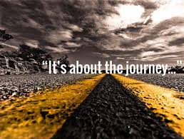

Slide 20
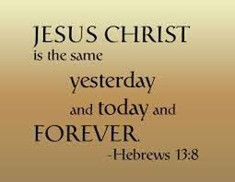

Slide 21
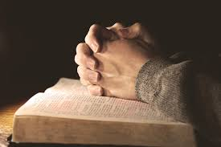

Slide 22
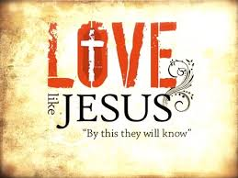

Slide 23
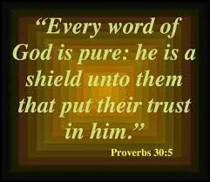

Slide 24
