Slide 1
July 3, 2016 So Good to see you today Church!

Slide 2
Psalms 139 (vs.9-10) Hide and Seek with God!

Slide 4
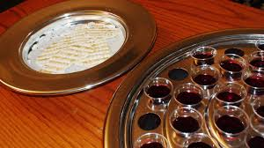

Slide 6
Psalms 139 (vs.9-10) Hide and Seek with God!

Slide 7
Introduction: One of the greatest truths in life which we all know, but which we all must come to learn, is that there is no escape from God. Like fugitives, we may run, but we cannot ultimately hide from the God who penetrates even the darkness with the gaze of His light.
If we manage to dodge Him in this life, we must still stand exposed before Him on that fearful day of judgment. There is no place to hide from God. Happy we will be once we allow ourselves to be found by Him, and once we discover that His intention is not to harm but to bless us. He formed us even in our mother’s womb for His purpose and ordained all of our day before we ever saw the light of day.

Slide 8
With David we must exclaim, “How precious also are Your thoughts to me, O God!” (v.17). In coming to know Him, we come to know ourselves. In the blinding light of His holiness, we recognize instantly the desperate need we have for inner purity.
Since we cannot escape from this all-knowing, all-present, all-wise Creator, we cannot escape from the need for holiness. That is the message beautifully crafted in Psalm 139.
Since I cannot escape from God, I must commit myself to holiness. The psalm falls into four stanzas. The first three deal with different attributes of this inescapable God as they relate to the individual: His omniscience (vs. 1-6); His omnipresence (vs.7-12); and, His omnipotence as the sovereign Creator (vs. 13-18). Final stanza (vs. 19-24) Our response-personal holiness.

Slide 9
1) I can’t escape God’s knowledge of me (1-6). God knows absolutely everything about me. He knows my actions, my ways, my words, my thoughts. Like a caged bird, He’s got me surrounded, with His hand upon me (v.5).
There is no escape from His thorough, penetrating knowledge. So David exclaims (v.6) “Such knowledge is to wonderful for me; it is to high, I cannot attain to it.” Our reaction probably is like David’s; “Where can I run to hide?” But we have a longing to know and be known, but only within safe limits. We fear being exposed. But the amazing thing is, This God who knows us so thoroughly, who knows every awful thought we ever have, desires to have a relationship with us.

Slide 10
2) I can’t escape God’s presence (7-12). Where would you like to run? Heaven (8)? God is there! The first Soviet cosmonauts irreverently joked that they didn’t see God from their spaceship. But God saw them! Do you want to escape God in the place of the dead (Sheol)? He’s there too!
Do you want to go east (v.9), or west (v.10). You won’t dodge God. You can hide in the dark, but God is light and He will find you (vs.11-12). David is intensely personal about this: God isn’t just everywhere; everywhere I go, He lays hold of me (v.10).

Slide 11
3) I can’t escape God’s power and sovereignty (13-18). The thought that darkness doesn’t hide us from God leads David to consider that God formed him in his mother’s womb. Though hidden from human eyes in that day before sonograms, David was not hidden from God’s eyes (v.16).
And not only did God make me through His creative power, but also He ordained all of my days before any of them came into being (v.16)! Augustine observed, “Men go abroad to wonder at the heights of mountains, at the huge waves of the sea, at the long courses of the rivers, at the vast compass of the ocean, at the circular motion of the stars; and they pass by themselves without wondering.”

Slide 12
Every person has in his or her body sufficient proof that God exists. To ignore that kind of evidence renders a person without excuse (Rom. 1:18-23). To say that something as finely balanced and complex as the human body is the result of sheer chance plus time is nothing short of ridiculous. So David is saying that we can’t escape God, He knows everything about you.
4) Therefore, I must commit myself to holiness (19-24).
The inescapable conclusion of the fact that we can’t escape from the living God is an inescapable commitment to holiness.
A) HOLINESS MEANS LIVING APART FROM THE WICKED (vs.19-22). Does the thought of “perfect hatred” strike you as odd? Does it seem like a vice rather than a virtue? We have a syrupy, sentimental notion of love in our day.

Slide 13
We strongly think that Christians should not hate anything. But to fear God is to hate evil (Prov.8:13). We can’t love God properly and be complacent about sin. Jude 22-23, “hating even the garment polluted by the flesh.” Holiness means living apart from the wicked and staying undefiled from their sin, but reaching out to them with the message of salvation.
B) HOLINESS MEANS LIVING OPENLY BEFORE GOD (vs.23-24).
David no sooner mentions the wicked and his hatred for their irreverence than he quickly realizes his own need for God’s cleansing. This is not so much a prayer that God may know him, but rather that David might know himself through God’s purifying, refining fire. We must constantly expose our inner life to God, and constantly yield our whole life to God. Search me! Lead me! Is what David request.

Slide 14
Conclusion: I agree with this statement by John Calvin; “It is certain that man never achieves a clear knowledge of himself unless he has first looked upon God’s face, and then descends from contemplating him to scrutinize himself.”
That’s what David is saying here: Look upon God; He knows you thoroughly; He is with you everywhere you go; He has wondrously created you and sovereignly ordained the days of your life. Then scrutinize yourself by inviting the searchlight of God’s Word into your innermost thoughts and feelings and by yielding yourself to be obedient to God’s ways. Since you can’t escape from God, you must commit yourself to holiness.

Slide 15
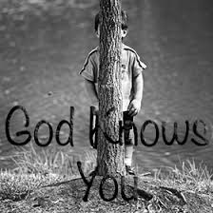

Slide 16
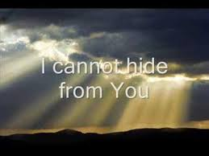

Slide 17
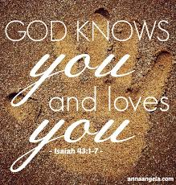

Slide 19
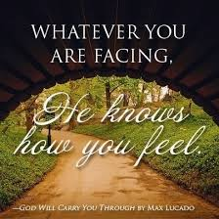

Slide 20
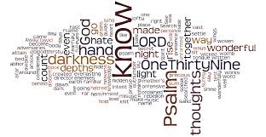

Slide 26
