Slide 1
September 4, 2016 Praise God for this blessed week.

Slide 2
Psalms 90:13-17 Seeing God As He Is!

Slide 3
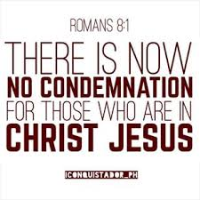

Slide 4
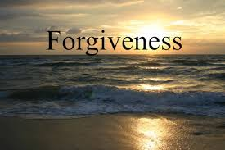

Slide 5
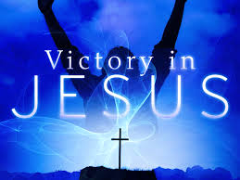

Slide 6
Psalms 90:13-17 Seeing God As He Is!

Slide 7
Introduction: Question? “How can my fleeting life have purpose or value?” “What makes life significant and worthwhile?” It seems to me that there are only two possible answers. One is the philosophy of the hedonist, “Eat drink, and be merry, for tomorrow we die.”
That view is flawed if there is a resurrection of the dead. The other view, which takes this fact into account, is the view of the Bible, that we must be linked vitally to the eternal God if we want our fleeting lives to have significance. Moses was a man surrounded by death. He led Israel out of bondage in Egypt to take them to the promised land. But because of their disobedience, God determined that generation should not enter the land, but die in the wilderness.

Slide 8
Even Moses died; only Joshua and Caleb lived to enter the promise land. If God’s judgment applied to everyone 20 and older when they came out of Egypt, over 1.2 million men and women died during the 40 years in the wilderness (Num. 1:45-46). There were a lot of graves in the desert!
As Moses saw these people whom he knew and had worked with over the years dropping like flies, he reflected deeply upon the question, “How can this fleeting life have meaning and value?” Instead of being driven to despair and cynicism, as many are who reflect on this question, Moses, being a man of God, was driven to worship and prayer. The result is the majestic Psalm 90, the oldest of the psalms, the only one in the psalter known to have been written by Moses.

Slide 9
(He wrote other poetry; see “The Song of Moses,” Deut. 32:1-43.) Moses’ inspired answer to the question of how , (lasting only a short while) life can have value is, Our fleeting lives can have value if we live wisely before the eternal God.
Lesson: The Psalm falls into four stanzas:
1) (90:1-2) The eternal nature of God.
2) (90:3-6) The temporary nature of man.
3) (90:7-11) God’s wrath over man’s sin as the cause of the temporary nature of man.
4) (90:12-17) A prayer for God’s mercy and grace in spite of man’s sin.

Slide 10
Lesson Points: *Life has meaning and value if we have a relationship with the eternal God and if we have God’s blessing upon our life and work.
A) A relationship with the eternal God give life meaning and value (90:1-2)
God’s resume in scripture:
1) He existed before anything else. (I Tim.6:16)
2) He created all things. (John 1:3)
3)He sustains all things. (Col. 1:17)
4) He is above all things. (Isaiah 46:9-10)
5) He knows all things. (Ps. 139:1-4)

Slide 11
6) He can do whatever He pleases. (Ps.135:6) 7) He orchestrates all things. (Isaiah 14:24) 8) He rules over all things. (Daniel 4:34-35) 9) He is in control of all things. (Prov. 21:1)
B) God’s blessing upon our life and work gives life meaning and value. (90:12-17)
Moses prays, “May the favor (delightfulness, pleasantness, beauty) of the Lord our God be upon us” (90:17).

Slide 12
Lesson Point: Life is futile apart from God because of its shortness and uncertainty and because of God’s wrath on our sin. 1) Life’s shortness and uncertainty make it futile apart from God (90:3-6). Moses describes our helplessness in the face of death as being swept away by a flash flood (90:5a).
2) God’s wrath on our sin makes life futile apart from God (90:7-11). Moses saw a lot of corpses! Possibly 30,000 a year or 82 a day, and some were killed because of rebellion and sin (Num. 16:49; 25:9).
Moses’ point is that the fact of death, which we see all around us, should make us aware that the wrath of the eternal God is upon the sinful human race. If we do not truly know this eternal God as our personal dwelling place, life is futile.

Slide 13
Closing: Three practical lessons. 1) Live in the light of eternity. Moses prays (90:12), “So teach us to number our days, that we may present to You a heart of wisdom.” One day you will present something to God. He has entrusted certain gifts and abilities to you and you are to manage
them for Him in such a way as to make a profit for His kingdom.
2) Labor for the lasting, not the passing. There is so much that we work for that doesn’t remain! We know, we need a certain amount of worldly things to live comfortably and to function efficiently in our modern world. But never forget that “the world is passing away, and also its lusts; but the one who does the will of God abides forever” (I john 2:17).

Slide 14
3) Avoid the waste that comes from sinful living. Israel was consumed by God’s anger (90:7-1) because of their disobedience. Sinful, self willed living always results in waste. While those who are in Christ need not fear God’s condemnation (Rom.8:1), we do need to fear the Lord and avoid sinning.
The law of sowing and reaping (Gal. 6:7-8) applies even under grace. Don’t be deceived: Sin always has adverse consequences in your life. Obedience always results in God’s blessing. Israel’s experience in the wilderness was written for our instruction, so that we don’t repeat their mistakes.
Story: A young man went into the remote Alaskan wilderness to photograph the beauty, but had made no provision to be flown out of the area. Are we prepared for our departure?

Slide 15
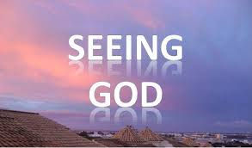

Slide 16
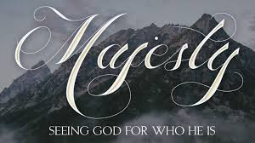

Slide 18
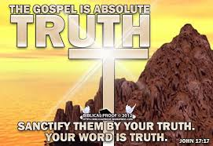

Slide 19
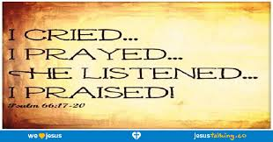

Slide 20
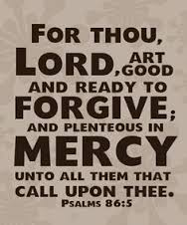

Slide 21
