Slide 1
October 23, 2016 The Lord knows those who are His!

Slide 2
Psalms 119:153-160 Nothing but the Truth!

Slide 4
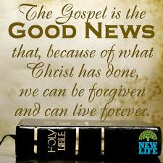

Slide 5
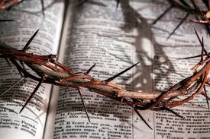

Slide 6
Psalms 119:153-160 Nothing but the Truth!

Slide 7
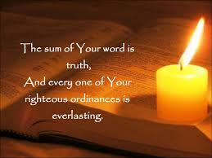

Slide 8
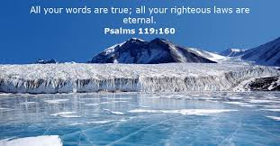

Slide 9
True: In accordance with fact or reality “a true story” Synonyms: correct, accurate, right, verifiable, in accordance with the facts, what actually/really happened, well documented. Accurate or exact, accurate, true to life, faithful, telling it like it is fact-based, realistic, close, lifelike, without variation. In verb form it means to bring (an object, wheel, or other construction) into exact shape, alignment, or position require.
From the beginning. God’s word has been true from the moment in which it was spoken, true throughout the whole of history, true to us from the instant in which we believed it, and true to us before we were true to it. Some read it, “ “Thy word is true from the head; true as a whole, true from top to bottom. The scriptures are as true in Genesis as in Revelation.

Slide 10
And every one of thy righteous judgments endureth forever. That which God decided remains irreversible in every case. There is not one single mistake either in the word of God or in the providential dealings of God. The Lord has nothing to regret or to retract, nothing to amend or to reverse.
All God’s judgments, decrees, commands, and purposes are righteous, and as righteous things are lasting things, everyone of them will outlive the stars. Know is as soon and as long as you will or can, and you shall never find it tripping or failing; but you may after long experience of God say of it, “I have known of old that thou has founded it for ever.” Why because in it we find stability and firmness for our lives.

Slide 11
The Psalter describes truth as a fundamental characteristic of God, a characteristic that the psalmists desires to share. The wicked do not speak truth (5:9), whereas the blameless one speaks from the heart (15:2). The psalmist often depict truth as a quality separate from God, and which God serves by virtue of His nature. In many instances, truth appears to be personified. The psalmists tells God to “guide me in your truth” (25:5); the psalmists asks God to “send forth your light and your truth” to lead him (43:3); the psalmists asks the Lord to “ride forth victoriously in behalf of truth” (45:4). The psalmist desires to walk in God’s truth (86:11). Indeed, the sum of God’s word is truth. It can and will touch every aspect of our lives.

Slide 12
Truth in man is in response to truth in God, and is to be acquired on the basis of a gift from God. This gift comes by way of teaching and also by way of the working of the Divine Spirit in the life of man. Highest truth in correspondence to ideal is possible only by the working of “the God of truth” in the spirit of man.
Man’s freedom to realize his being is dependent upon his receptive attitude toward the Son of God. Hence salvation in its fullest idea is stated in terms of truth (Jn.11:3; Phil.3:10).
The Synoptic Gospels scarcely use the word truth at all, while in John is it extremely significant term referring to Jesus and his ministry. Jesus, as the Word become flesh, is full of grace and truth (1:14), and is the source of grace and truth (1:17).

Slide 13
Two reasons God’s word should find a place of priority in our lives: 1) Because the Bible is God’s Word. 2) Because of what God’s Word can do in our lives, because it is True.
1) God’s word is Authoritative: It is that which I turn to as a text book for my life. When God speaks, He does not mumble. The bible is not a book of helpful hints for happy living. It speaks with divine authority.
2) God’s word is reliable: It will always give me what in any circumstance in life I need. You can trust what you read. All of it is faithful, righteous, and true. It doesn’t change with time. One of the amazing things about the Bible is that it speaks with practical relevance to every culture in every period of history.

Slide 14
3) God’s Word is Powerful: Down through the centuries the Bible has had life-transforming effects in the lives of countless people from every conceivable walk of life. A) The Word brings us into a living relationship with the living God. We don’t study to become Bible scholars. Nor do we study it simply to learn and follow its moral precepts, although we should do that. We study the Bible to seek God Himself.
B) The Word gives us stability in trials. I have heard many times, “God didn’t cause this trial; He just allowed it,” as if that gets God off the hook! People are afraid that if we say that God caused a trial, it robs Him of His goodness. We may not understand God’s purpose in our suffering, but we can know and must affirm by faith that He is both sovereign and good.

Slide 15
C) The Word gives us Direction in life. We all have to make hundreds of decisions that determine the outcome of our lives. Some are minor, some are major; but they all clump together to shape our lives. In the complex world in which we live, we desperately need God’s wisdom for making sound decisions.
D) The Word produces Purity in our lives. Each of us wrestles with the problem of inward purity. We might be able to put on a good show outwardly, but inwardly we are sinners by nature and we wage war against wrong thoughts, desires, and attitudes. God Word is essential for becoming pure in heat.

Slide 16
E)The Word gives us Joy and Delight. Some Christians are “castor oil” Christians; “The Bible is bitter, but good for what ails you.” “A chapter a day keeps the devil away.” Others are “shredded wheat” Christians; the Bible is dry, but nourishing. But the true Word of God can bring joy into our lives, even in the midst of afflictions. We can know joy if we choose that which is TRUE!

Slide 17
Conclusion: There is only one thing in this world that has been true, will be true and will remain true for eternity, God’s word. Test it and see if it doesn’t provide True answers in the midst of challenges or trials in this life, and bring the joy and delight I spoke about.
True in verb form brings this emphasis: to bring (an object, wheel, or other construction) into the exact shape, alignment, or position required. This is what God’s True word can do for us. Bring us in alignment with Him and the exact position He would have us.
*Starving children! What if God could give each of us a snapshot of our spiritual condition. Would we look like those children. Stay with what is True-God’s Word.

Slide 18
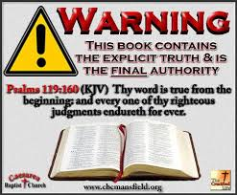

Slide 19
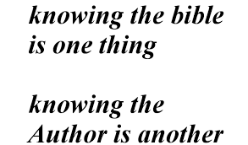

Slide 20
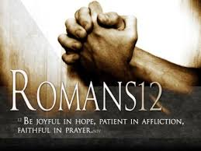

Slide 21
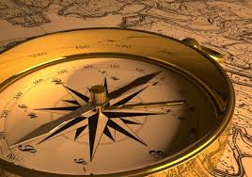

Slide 22
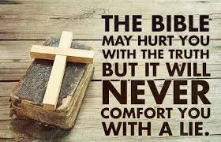

Slide 23
