Slide 1
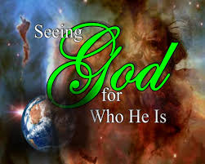
May 21, 2017 Glorify God this day!

Slide 2
Why the Church is Important! 1 Timothy 3:14-16

Slide 3
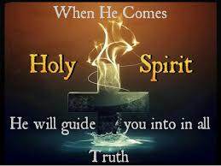

Slide 4
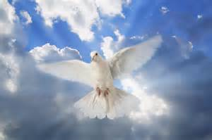

Slide 6
Why the Church is Important! 1Timothy 3:14-16

Slide 7
Intro: You are important to God! Because you apart of the church locally, and universally. 1) Locally-The local church is described in Gal.1:1-2: “Paul, and apostle…and all the brothers with me, to the churches in Galatia.” Here we see that in the province of Galatia there were many churches-what we call local churches.
2) Universal- This consists of all those who have a personal relationship with Jesus Christ. “For we were all baptized by one Spirit into the body-whether Jews or Greeks, slave or free-and we were all given the one Spirit to drink” I Cor.12:13. The universal church of God is all those who have received salvation through faith in Jesus Christ.
II Timothy 2:19 God knows those who are His.

Slide 8
If you were to ask the person on the street, “Why is the church important?” you would probably get a wide range of answers. Some would laugh at the question, because for them the church is not important in any way. Others might see the church in the same category as museums: They both preserve things from the past. They’re a nice place to visit on rainy days, but they’re out of touch with our modern world.
Others might couch their answers in political terms: They view the church as a powerful voting block to oppose the erosion of morality and to preserve the family. For many Americans churchgoers, the church is important because it meets many of their personal needs. They shop around for a church that makes them feel good each week, so they can cope with life.

Slide 9
One man who was ask this question said, “I believe the church of Jesus Christ is the most important force in the world today. Its task is more important than all the governments and universities of the world combined. There is nothing to compare with it!” “Because the most significant event in human history was when the living God took on human flesh and lived among us as the
Lord Jesus Christ to bear our sins. And since He ascended into heaven, His church now reveals Him on earth, even as He revealed God when He was on earth,” So the church is important because it reveals Christ, even as Christ reveals God in human flesh.

Slide 10
Lesson: That is essentially what the Apostle Paul, is saying in I Timothy 3:14-16. The church is the continuing incarnation of God incarnate. The word “incarnate” comes from two Latin words meaning “in flesh.” It means that God took on a human body in the person of Jesus Christ. And since Jesus ascended into heaven, we now, as His body continue His presence on earth until He
returns. The Lord wants us as His people to catch a vision of the incomparable importance of the church in its role of revealing the risen, ascended Christ. In order to catch that vision, we must understand the significance of Christ’s incarnation.

Slide 11
1) Jesus reveals God in human flesh. (3:16) In our text, Paul tells Timothy his purpose for writing, namely, so that God’s people would know how to conduct themselves as member of God’s church. A key function of the church is to be the pillar and support of God’s truth which centers in the person of Jesus Christ. Thus Paul, in verse 16 quotes an early church hymn to elaborate on the core of truth as it centers in Christ.
A) “Revealed in the flesh” (Jn. 1:14) “In the beginning was the word, and the Word was with God, and the Word was God.” In verse 14, John continues, “And the word became flesh, and dwelt among us….”

Slide 12
B) “Was vindicate in the Spirit” He was declared Justified or righteous. When Jesus identified Himself with sinners by submitting to baptism, the Spirit “justified” Him by descending on Him as a dove.
C) “Beheld by angels” Announced the conception to Mary, Proclaimed His birth to the shepherds, ministered to Him after His temptation in the wilderness, strengthened Him in His agony in the Garden, proclaimed His resurrection at the tomb, addressed the disciples at Christ’s ascension.
D) “Proclaimed among the Nations” The disciples were told to take the message of salvation to Jew and all nations.

Slide 13
E) “Believed on in the world” This is the only means that God ordained for every person around the world to receive the gift of eternal Life: John 3:16, “For God so loved the world…” F) “Taken up in Glory” This refers to the bodily ascension of the risen Lord Jesus. Paul’s point in verse 16, then is that the incarnate Son of God reveals the Father to us. And the connection between verse 16 and verse 15 is, just as Jesus reveals God, even so….
2) The church reveals Christ to the world (3:14-15). God continues to be incarnate, not only in Jesus, but also in the church. Jesus is God incarnate; the church is Jesus incarnate. Jesus is not only incarnate in heaven now; He is also incarnate in His body, the church.

Slide 14
We are the visible expression to the world of the Savior who is presently in heaven. Paul shows the importance of the church by three word pictures.
A) “The Household of God” This term views the church as the extended family of God, with God as the head of the household. It mainly focuses on the relationships which should be built among those in the church which should reflect Christ to the world. In America, we tend to be individualistic and goal oriented, and it affects our view of the church. We tend to see the church as an organization that ought to have clearly defined goals and offer programs in line with those goals to meet our needs. But isn’t it enough to just gather unto Christ as God’s household or family.

Slide 15
B) He does no say simply, “the church of God,” but rather, “the church of the living God.” That is the church is the place where the living God actually dwells and is at work. Just as the phrase “the house hold of God” focuses on our relationships with one another, so the phrase “the church of the living God” focuses on our relationship with God (Rom.9:25-26).
The word “church” means “called out ones.” We have been called out of this sinful world to be a holy people, set apart unto the living God who dwells within us and among us. There’s a serious danger which both individuals and churches must guard against-institutional religion. It’s so easy to fall into routine Christianity, where you run through your programs and activities, but you don’t live in close touch with the living God.

Slide 16
You even can have a personal quiet time, but not meet with God. You can go to church and go through the worship service, but you haven’t made contact with the living God.
C) “the Pillar and support of the Truth” In one sense, the truth is absolute and independent of us. God’s truth as revealed in Jesus is-true whether or not we believe it or proclaim it. But in another sense, the church upholds and support the truth. Have we forgotten our great priveledge and responsibility, in being the pillar and support of the truth. Have we in our daily walk, minimized biblical truth in favor of things like modern psychology and American marketing techniques. Sometimes we are big on spiritual experiences, emotions and methods, but we’re weak scripturally. Truth is not merely to fill our heads.

Slide 17
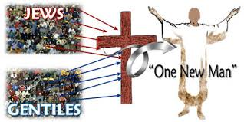
It is to affect our lives. The truth concerning God incarnate is transforming truth. And so the church acts as the pillar and support of the truth by putting truth into daily life. As people in the world observe the church, our conduct should undergird and uphold the doctrinal truth concerning our God who was revealed in the flesh.

Slide 19
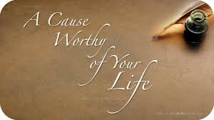
The church is of vital importance in the world today because we are called out of this sinful world as a holy people, in close relationship with the living God who dwells in our midst.

Slide 20
Conclusion: Why is the church important? Because God has left it here to reveal His Son to the world, even as Jesus revealed God when He was on this earth. As the household of God, the church of the living God, the pillar and support of the truth, we are the current expression of Jesus in the world until He comes.
Would it not be great to hear people say, “I have seen the living God dwelling among His people.”
*One pastor told a story about a phone call he got in his office. The person on the phone asked, “Do you expect the President to be there Sunday? His response was, “That I cannot promise. But we do expect God, and we fancy it will be incentive enough for a reasonably large attendance.” We need to expect the living God to meet with us.

Slide 21
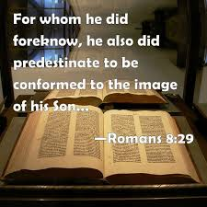

Slide 22
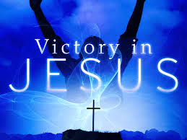

Slide 23
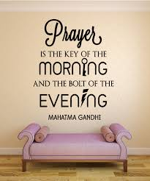

Slide 24
