Slide 1
June 4, 2017 God Loves You!

Slide 2
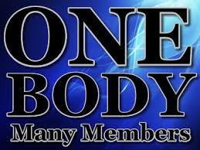
How is the church the Body of Christ? I Cor. 12:12-18

Slide 3
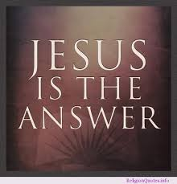

Slide 4
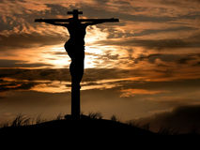

Slide 6
How is the church the Body of Christ? I Cor. 12:12-18

Slide 7
Intro: The phrase “the Body of Christ” is a common New Testament metaphor for the Church (all those who are truly saved). The Church is called “one body of Christ” in Rom 12:5, “one body” in I Cor. 10:17, “the body of Christ” in I Cor. 12:27 and Eph.4:12. and “the body” in Heb. 13:3. The Church is clearly equated with “the body” of Christ in Eph. 5:23 and Col.1:24.
When Christ entered our world. He took on a physical body “prepared” for Him (Heb.10:5, Phil. 2:7). Through His physical body, Jesus demonstrated the love of God clearly, tangible, and boldly-especially through His sacrificial death on the cross (Rom. 5:8). After His bodily ascension, Christ continues His work in the world through those He has redeemed-the Church now demonstrates the love of God clearly, tangibly, and boldly.

Slide 8
In this way, the Church functions as “the Body of Christ.”
The Church may be called the Body of Christ because of these facts: We have all these in common with one another.
1) Members of the Body of Christ are joined to Christ in salvation (Eph. 4:15-16).
2) Members of the Body of Christ follow Christ as their Head (Eph. 1:22-23).
3) Members of the Body of Christ are the physical representation of Christ in this world. The Church is the organism through which Christ manifest His life to the world today.

Slide 9
4) Members of the Body of Christ are indwelt by the Holy Spirit of Christ (Rom. 8:9). 5) Members of the Body of Christ possess a diversity of gifts suited to particular functions (I Cor. 12:4-31). “The Body is a unit, though it is made up of many parts, and though all its parts are many, they form on body. So it is with Christ” (verse 12).
6) Members of the Body of Christ share a common bond with all other Christians, regardless of background, race, or ministry. “There should be no division in the body but…its parts should have equal concern for each other” (I Cor. 12:25).
7) Members of the Body of Christ are secure in there salvation (Jn.10:28-30). For a Christian to lose his salvation, God would have to perform an “amputation” on the Body of Christ!

Slide 10
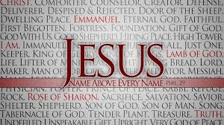
8) Members of the Body of Christ partake of Christ’s death and resurrection (Col. 2:12). 9) Members of the Body of Christ share Christ’s inheritance (Rom. 8:17). 10) Members of the Body of Christ receive the gift of Christ’s righteousness (Rom. 5:17).

Slide 11
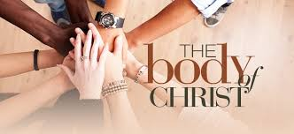
One body in that which is COMMON among Us! I can’t say to you your not important, and you should not say to yourself. *Salvation *Diversity of gifts *Followers of Christ *Fellowship/common *Made to represent Christ * Security in Salvation *Indwelt by Holy Spirit *Partakers/Christ’s death, Resurrection *Christ’s Inheritance *Gift of Righteousness

Slide 12
Con: As a part of the church, a unit, body, and having all these things in common with one another, The Father is glorified. His worth is shown. What can we do to enhance this body of Christ? The body is a Holy entity and is to be respected and treated with complete honor and care. The Bible again provides several action principles for building up the body of Christ.
You are called to promote truth and unity. Eph.4:25
You are called to service. I Cor. 12:4-11
You are called to share Jesus. Rom. 1:16
You are called to worship. Psalms 92:1-2
You are called to love each other. I Jn. 4:11

Slide 13
The Body of Christ, like all bodies, is comprised of many parts. There are limbs, organs, and various members that, when left alone, are useless, but when assembled make up the entire body. (I cor. 12:12-14) described it like this. “The body is a unit, though it is made up of many parts, and though all its parts are many, they form one body. So it is with Christ.” This means each Christian is an equal part of the body of Christ.
We need to ask ourselves. Am I a contributing member? Am I actively serving God and sharing Him with others? Am I contributing to peace and unity within? Do I worship regularly? Take a look at yourselves and see the room to grow in your walk with Christ and His body. Reminder: You are a Holy creation of God looking to Heaven, as a reward.

Slide 14
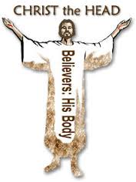

Slide 15
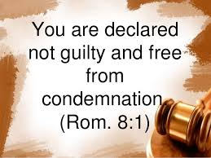

Slide 16
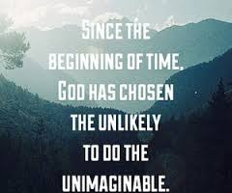

Slide 17
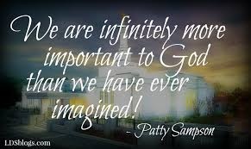

Slide 18
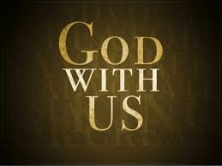

Slide 19
